Slide 1
Architectural Analysis of Multi-Level Cache Hierarchies using gem5
Course: Computer Architecture (BEVD207L)
Members: Dhvanit Ghadawala (24BVD0004)
Devanuj Roy (24BVD0157)

Slide 2
Problem Statement
The efficiency of the cache is a major bottleneck for overall program execution time.
Optimization is critical, as a poor configuration leads to wasted silicon area or degraded performance.
Since there is no "one size fits all" rule, design choices must be tailored to specific workloads.
We investigated the impact of cache size and associativity on CPI and miss rates within a 2-level hierarchy.
To get concrete data, we conducted an empirical study using the gem5 simulator.

Slide 3
Why Cache is Needed
The "Memory Wall": A significant performance gap exists between fast CPUs and slower main memory.
Impact of No Cache: Without caching, the CPU wastes operational time idling while waiting for data retrieval.
Level 1 (L1) Cache: Small, ultra-fast memory located directly on or near the CPU for immediate data access.
Level 2 (L2) Cache: Larger and slightly slower than L1, acting as a secondary data backup.
Reduced AMAT: This tiered hierarchy keeps frequently used data close to the processor, significantly lowering the Average Memory Access Time (AMAT).

Slide 4
Inclusion Concept
Inclusive Cache: L2 duplicates L1 data; this simplifies coherence protocols but wastes L2 storage space.
Exclusive Cache: L2 only holds data evicted from L1; this maximizes effective capacity but increases system complexity.
Default Configuration: Our baseline setup utilizes gem5's inclusive L2 policy.
Size Analysis: We investigated how modifying cache sizes impacts the tradeoff between these two policies.

Slide 5
What We Actually Implemented
Built a two-level cache system using gem5 (two_level.py)
Ran a simple "Hello World" test binary on X86 TimingSimpleCPU
Experiment 1: Changed L2 cache size (256KB vs 512KB)
Experiment 2: Changed L2 associativity (2-way, 4-way, 8-way)
Collected CPI and L1/L2 miss rates from stats.txt for each run

Slide 6
System Design
Architecture Flow: CPU → L1 (I/D-Caches) → L2 Bus (XBar) → L2 Cache → Memory Bus → DDR3 RAM.
CPU Configuration: X86TimingSimpleCPU operating at 1 GHz.
L1 Cache: Separate instruction and data caches linked directly to CPU ports.
L2 Cache: Interconnected using an L2XBar crossbar.
Main Memory: DDR3_1600_8x8 configuration with a 512MB address range.

Slide 7
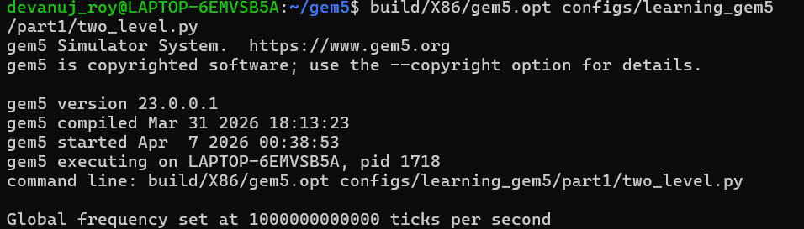
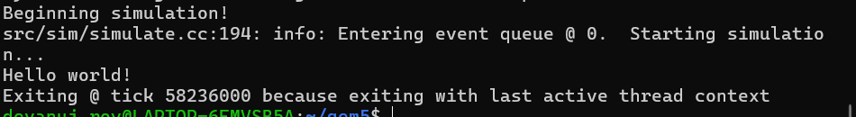

Slide 8
Cache Parameters
L1 Instruction Cache: 16KB capacity, 2-way set associative, with 2-cycle tag and data latencies.
L1 Data Cache: 64KB capacity, 2-way set associative, with 2-cycle tag and data latencies.
L2 Cache Parameters: Evaluated across variable sizes (256KB, 512KB) and associativities (2-way, 4-way, 8-way).
L2 Default Latencies: Configured at 20 cycles each for tag, data, and response.
Queue Configuration: 20 Miss Status Holding Registers (MSHRs) allowing up to 12 targets per MSHR.

Slide 9
Experiment 1 — Cache Size
Changed L2 cache size: 256KB vs 512KB
All other parameters kept constant (assoc = 8)
Hypothesis: larger L2 should reduce miss rate and improve CPI
Config changed in L2Cache class in caches.py
Ran two separate simulations, compared stats.txt outputs

Slide 10
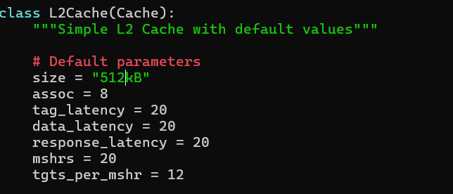
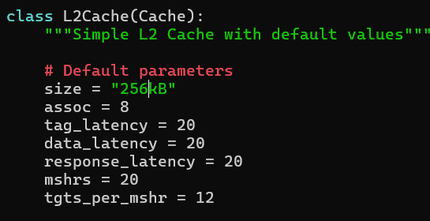

Slide 11
Results — Cache Size (CPI + Miss Rate)
L1 D-Cache Performance: The miss rate remained constant at 0.007861, as expected since L1 parameters were unmodified.
L2 Miss Rate Reduction: Increasing the L2 size yielded a dramatic drop in miss rate, falling from 0.999316 (at 256KB) to 0.027139 (at 512KB).
CPI Improvement: Cycles Per Instruction (CPI) improved by approximately 9%, decreasing from 4.579511 to 4.148587 with the larger L2 cache.
Key Conclusion: Doubling the L2 capacity successfully mitigated L2 cache misses and boosted overall system performance without impacting L1 behavior.

Slide 13
Experiment 2 — Associativity
Experimental Variables: Kept the L2 size fixed at 512KB while varying associativity across 2-way, 4-way, and 8-way configurations.
Role of Associativity: Dictates the number of cache lines that can be stored within a specific cache set.
Hypothesis: Increasing associativity from 2-way to 8-way will decrease the frequency of conflict misses.
Implementation: Configuration changes were executed using the --l2_assoc flag within the two_level.py script.

Slide 14
Results — Associativity (Miss Rate)
L2 Miss Rate Trends: The miss rate decreased significantly when moving from 2-way (0.981769) to 4-way (0.913847) associativity, but plateaued at 8-way (0.913678).
CPI Trajectory: Cycles Per Instruction (CPI) mirrored this trend, improving from 4.788218 (2-way) to 4.747729 (4-way), with negligible further gains at 8-way (4.747693).
Conflict Miss Resolution: The substantial performance jump between 2-way and 4-way indicates that a 4-way setup resolves the majority of conflict misses.
Diminishing Returns: For this specific workload, increasing associativity beyond 4-way yields minimal additional performance benefits.

Slide 15
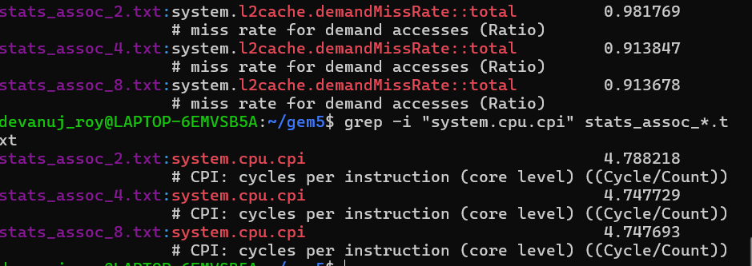

Slide 16
Key Observations
Impact of Cache Size: Cache capacity has the most significant influence on system performance, as undersized caches result in near-total miss rates.
Associativity Scaling: Increasing associativity provided substantial benefits at lower values (transitioning from 2-way to 4-way), but yields diminishing returns beyond that threshold.
L1 Cache Stability: The L1 miss rate remained strictly identical across all experimental runs, confirming that the primary L1 cache was not the system bottleneck.
CPI Correlation: Cycles Per Instruction (CPI) closely tracks the L2 miss rate, demonstrating that memory access stalls are the dominant factor in execution runtime.
Workload Sensitivity: Even basic, simple workloads exhibit clear and measurable performance degradation trends when subjected to undersized cache configurations.

Slide 17
Conclusion
Cache size is the most critical parameter for miss rate and CPI
Doubling L2 from 256KB → 512KB cut miss rate from ~99% to ~2.7%
Associativity improvements plateau beyond 4-way for simple workloads
gem5 is effective for validating architectural decisions before hardware
Inclusion policy amplifies the effect of size — smaller inclusive caches hurt more

Slide 18
Future Scope
Test with memory-intensive benchmarks (matrix multiply, sorting)
Implement explicit exclusive L2 and compare directly with inclusive
Vary L1 size to study L1 vs L2 tradeoffs
Explore different replacement policies (LRU vs Random vs FIFO)
Extend to multi-core setup and study cache coherence overhead

